Slide 1
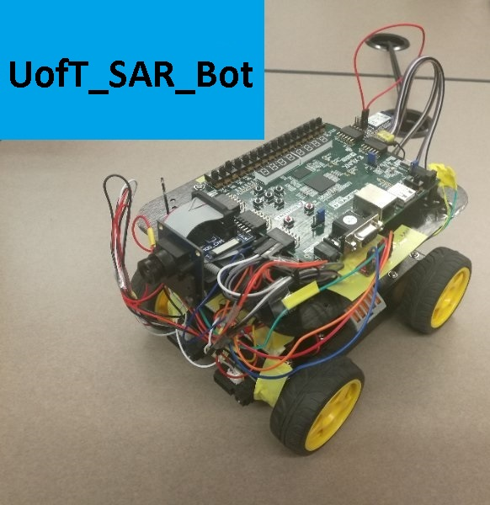
UofT_SAR_Bot
ECE 532H1S
TEAM 9
Bojian Zheng
Jinghan Guan
Kejian Lin
Ahmed Sageer Cheriya Melat

Slide 2
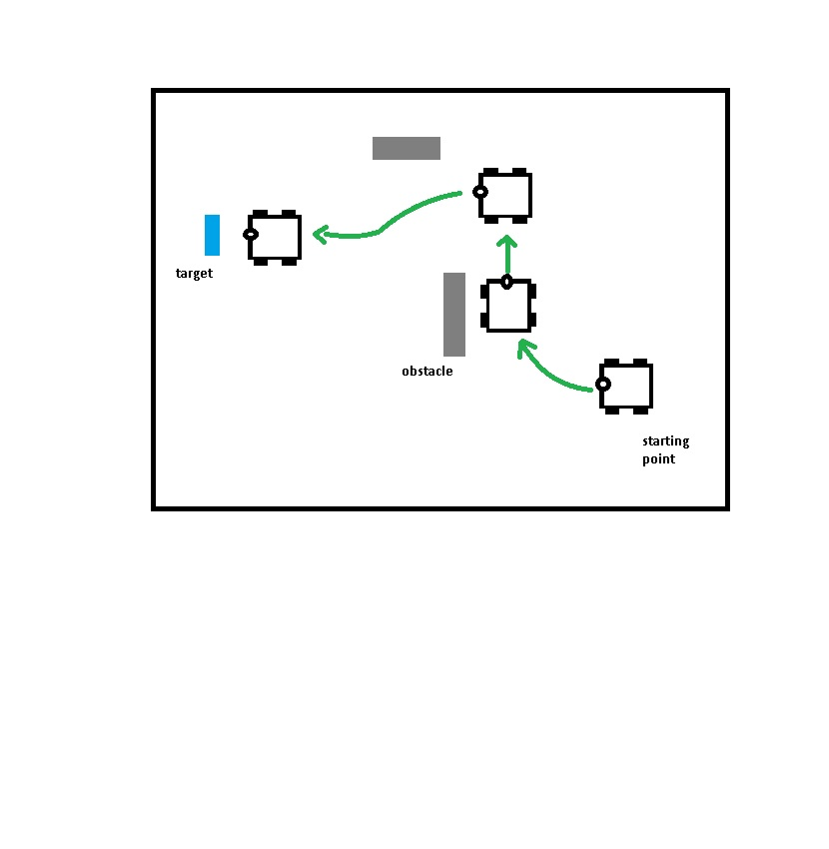
UofT_SAR_Bot TASK
UofT Search And Rescue Robot
Follow a target object (Blue screen)
Avoid dangerous collision with obstacles and take possible alternate path

Slide 3
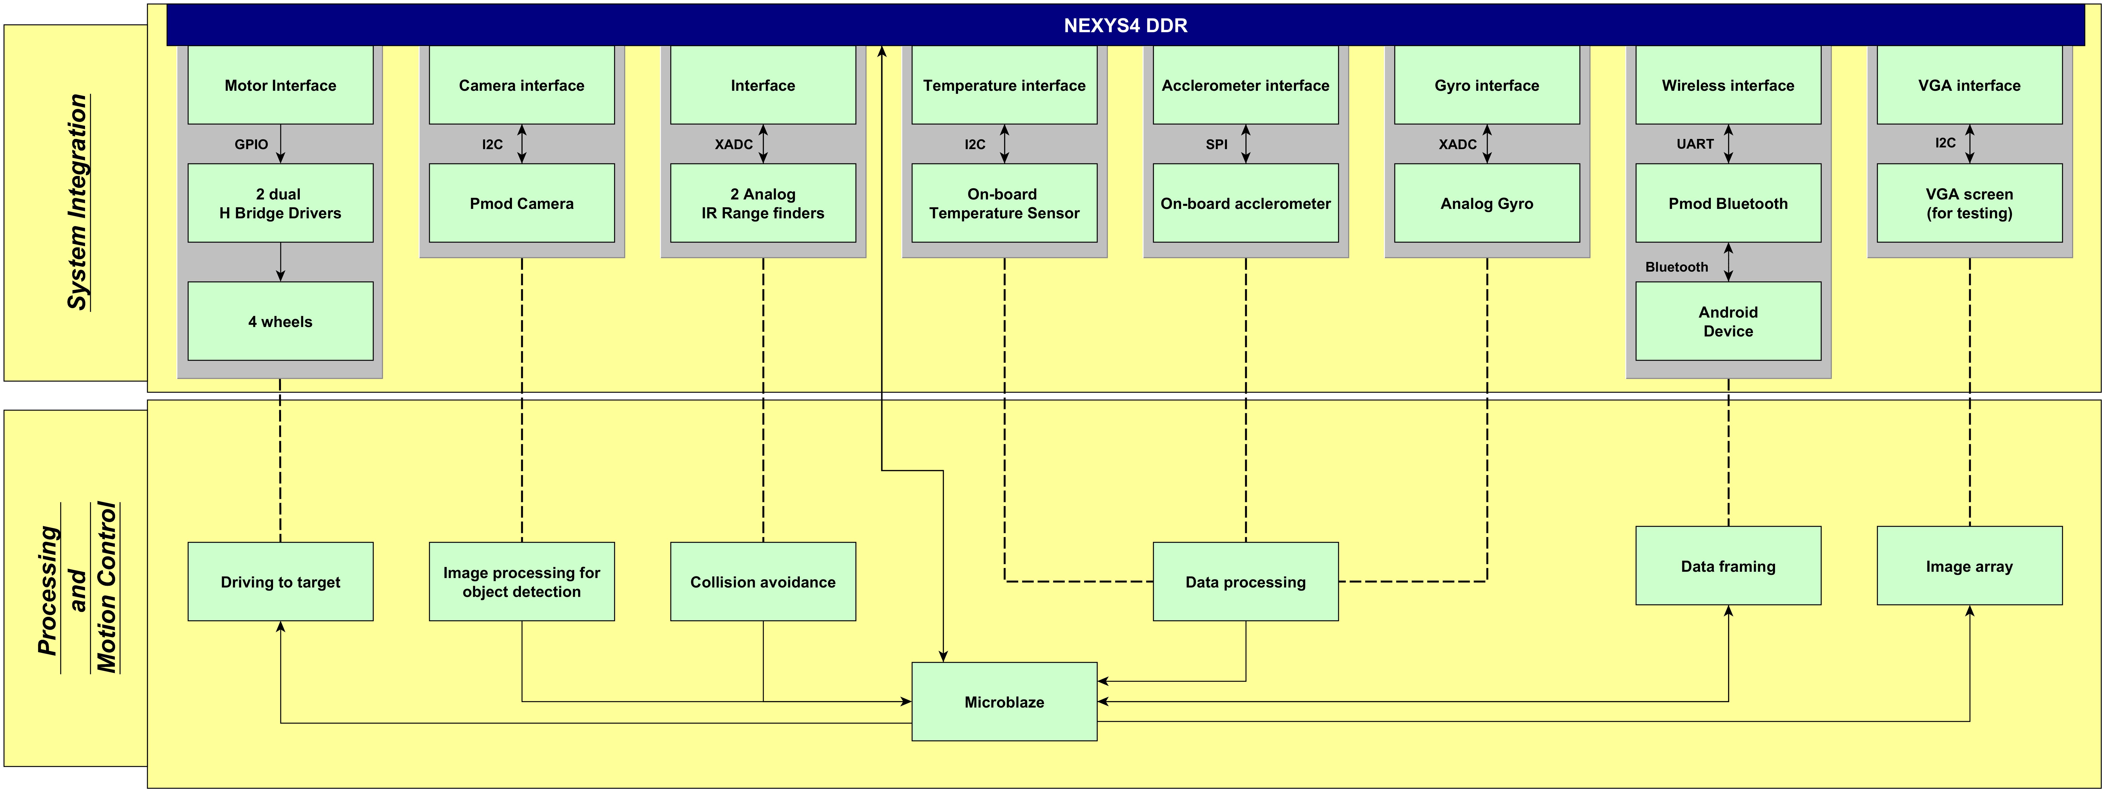
ARCHITECTURE

Slide 4
Components
Nexys 4 DDR board
Camera: Omnivision OV7670
On-board accelerometer: Analog devices ADXL362
range: -2g to +2g; sensitivity: 1mg /LSB
On-board temperature sensor: Analog devices ADT7420
range: -40 to 150 °C
Range finders: Sharp GP2Y0A41SK0F IR analog type
range: 4 to 30 cm
Gyroscope: Invensense IXZ-500 dual axis analog gyro
range: -110 to 110 °/s; sensitivity: 9.1mv/°/s
Motor control: LG L9110 Dual H bridge drivers
Bluetooth: Pmod BT2
Baud rate: 9600 bps
Android device with java based UofT_SAR_Bot application installed
Robot chassis, 4 DC motors, electric circuitry, etc.

Slide 5
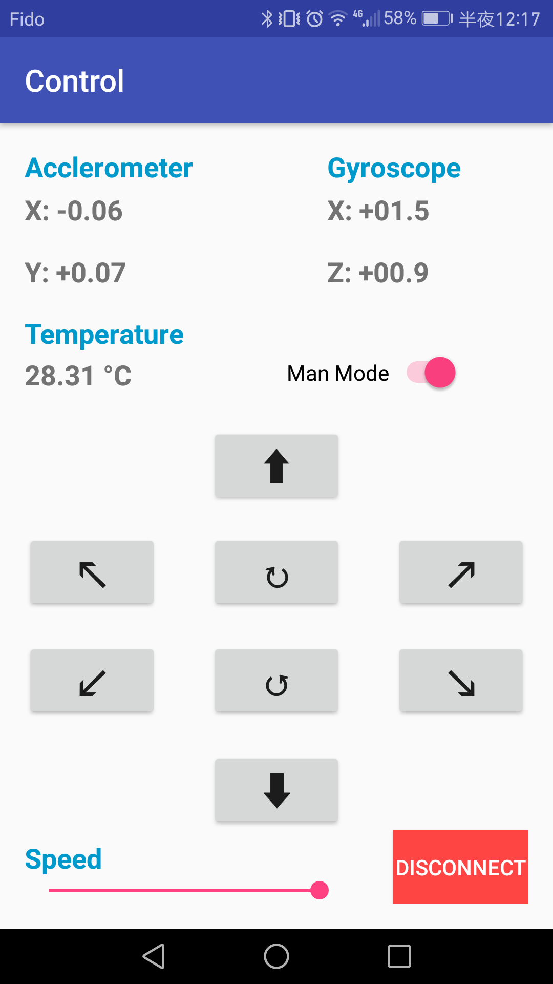
Remote Control
Java Based application on android platform
Bluetooth Communication
Units
Acclerometer : g
Gyroscope : °/s
Temperature : °C
Manual mode and auto mode operation

Slide 6
THANK YOU

Slide 7
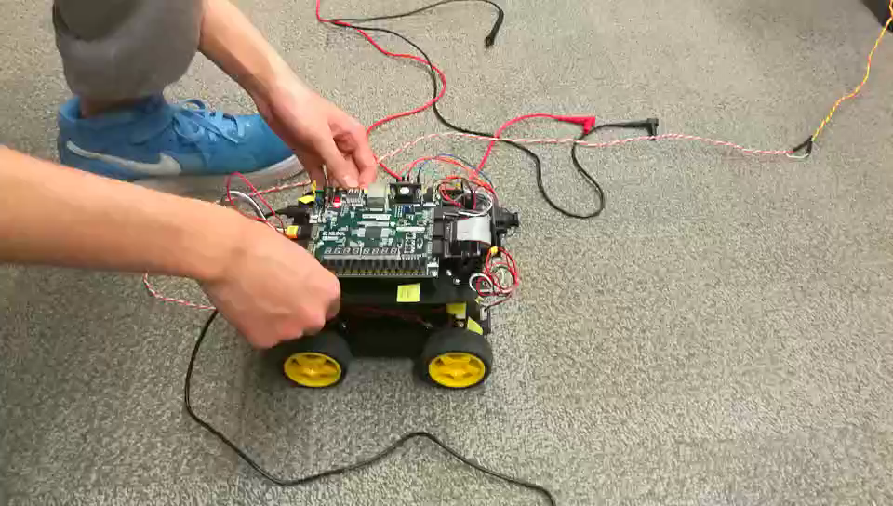
Video

